Slide 1
Office of Research & Development
Dial in (Main): (415) 930-5321
Dial in (Alt): (646) 307-1722
Access Code: 449-343-120
Slides in “Handout” Tab
Impacts on Research Field Operations from COVID-19
Status Report and Ways Forward
April 29, 2020

Slide 2
Purpose
To provide the field with an update on the impact of COVID-19 on the operations
To provide guidance in certain key areas
  Finance
  Communication
  Project Modifications
  BSL3
  Biorepositories
To start thinking about ramping back up - Labs
Continue the dialogue: Utilizing ORDCovid19@VA.gov to submit issues, ideas, concerns

Slide 3
Presenters
Rachel Ramoni, DMD, ScD – Chief Research and Development Officer (CRADO)
Tony Laracuente – Director of Research Operations, Atlanta VA Health Care System
Marisue Cody, PhD – Director of Operations, ORD
Mitch Mirkin – Supervisory Writer/Editor, Office of Communications, ORD
Allen Dunlow – Director of Finance, ORD
Miriam Smyth, Ph.D. – Deputy Director, CSRD, ORD
Karen Jeans, PhD, RN – Director of Regulatory Affairs, ORPPE, ORD
Mike Fallon, PhD, DVM - Chief Veterinary Medical Officer
Holly Krull, PhD – Deputy Director, BLRD, ORD
Amanda Hunt, PhD – Scientific Program Manager, BLRD, ORD
Kari Points – Director of Research Operations, Iowa City VA

Slide 4
Outline of Webinar
Overview of organization between ORD and Field
Field Operations
Adjustments to Budgets from COVID-19 (ABC working group)
  Overview
  Finance
  Project Modifications
Communications and Notification Request
ORPP&E
Animal Research
BSL3
Biorepositories and Sample Collections
Ramping Up

Slide 5
CRADO Comments
Welcome
Rachel Ramoni
Chief Research & Development Officer

Slide 6
ORD COVID-19 RESPONSE TEAMS
Rachel Ramoni, DMD, ScD – Chief Research and Development Officer (CRADO)
Grant Huang – Dep CRADO – Enterprise Optimization (Acting)
Molly Klote – Director, ORPPE
Wendy Tenhula – Dep CRADO
Marisue Cody – Director, ORD Operations
Amanda Garcia, Mary Kelleher, Mitch Mirkin
Public Health
Pathology/ Lab Med
PBM
_____
Privacy
OGC/STAR
ISSO-RSD
ORO
Research Steering Committee
Coordination/Review of ORD supported research activities on dx, tx, prev & mgmt.
Robert Bonomo
Sheldon Brown
Scott DuVall
Vince Marconi
Mark Holodniy
Chris Woods
Jack Stapleton
Field Research Ops
Coordination & disseminate info to maintain research COOP & safety of study participants; help with understanding implications of COVID-19 activities/decisions
Marisue Cody
Tony Laracuente
Mike Fallon
Terri Gleason
Holly Henry
Sharon Jacky
Kari Points
Maria Rodriguez
ORD Staff Safety & COOP
Protect ORD staff and ensure COOP within VACO
ORD Service AOs
ORD Employee Engagement Team
Vicky Davey
(interagency)
Jane Battles
(ORD/VA)
Biospecimen Collection Protocol
Clinical Trials
- tx, prev, diag
Other (e.g., observational, data/epi, HSR)
Draft 3/18/2020

Slide 7
Field Operations Workgroup
Membership composed of Field and ORD Representatives
Charge – to address issues that impact field operations: to give ORD a forum to discuss concerns raised by the field that impact operations
  Meet weekly (with some weeks having 2 meetings – depending on volume)
  Format
    Hot Issues from Field
    Communications
    ORD updates
    Follow Up items

Slide 8
Field Operations Workgroup
Consolidate communications effort
Vet FAQs document
Financial Impact
Addressing the unknowns (Telework, Leave, impact on CDAs and projects) – local or national
Operationalizing studies using BSL3
Project Modifications
Return to work

Slide 9
Adjustments to Budget from COVID Impact (ABC)
Charge:
  Planning for short-and long-term financial impacts of COVID-19. Carry over Management
  Developing management project-based budget modifications.
  Addressing enterprise-wide research budget questions systematically

Slide 10
Carryover Management
4% remains the targeted carryover
Stations have experienced varied impacts to their Research Mission as a result of the pandemic – one National solution can not address all the situations
Though maximum effort should be made to minimize carryover, stations that fail to achieve the 4% target will not be penalized
Stations which anticipate not achieving the 4% target will be asked, prior to the end of the FY, to provide a spreadsheet identifying which projects are behind in execution and the dollar value that will be carried over per project

Slide 11
Carryover Management Continued
Research offices should immediately execute PY funding so investigators have a clean picture of their potential CY carryover amount
ORD continues to work with field representatives to determine the fiscal impact caused by COVID-19 for both FY20 and FY21

Slide 12
Project Modification Opportunity (PMO) update
For Merit, SPiRE, Pilot and CDA ending 4/30/20 - 9/30/20
Services offering one-time no cost extension (NCE) of up to 6-months duration
No PMO form required
Services will send spreadsheet to stations with list of qualifying projects
Stations check ‘yes’ or ‘no’ in NCE column and insert duration required (1-6 mo)
Station must confirm that proposed research will be completed by the end of the NCE - no additional extensions will be allowed
For all other requests, follow the normal PMO process

Slide 13
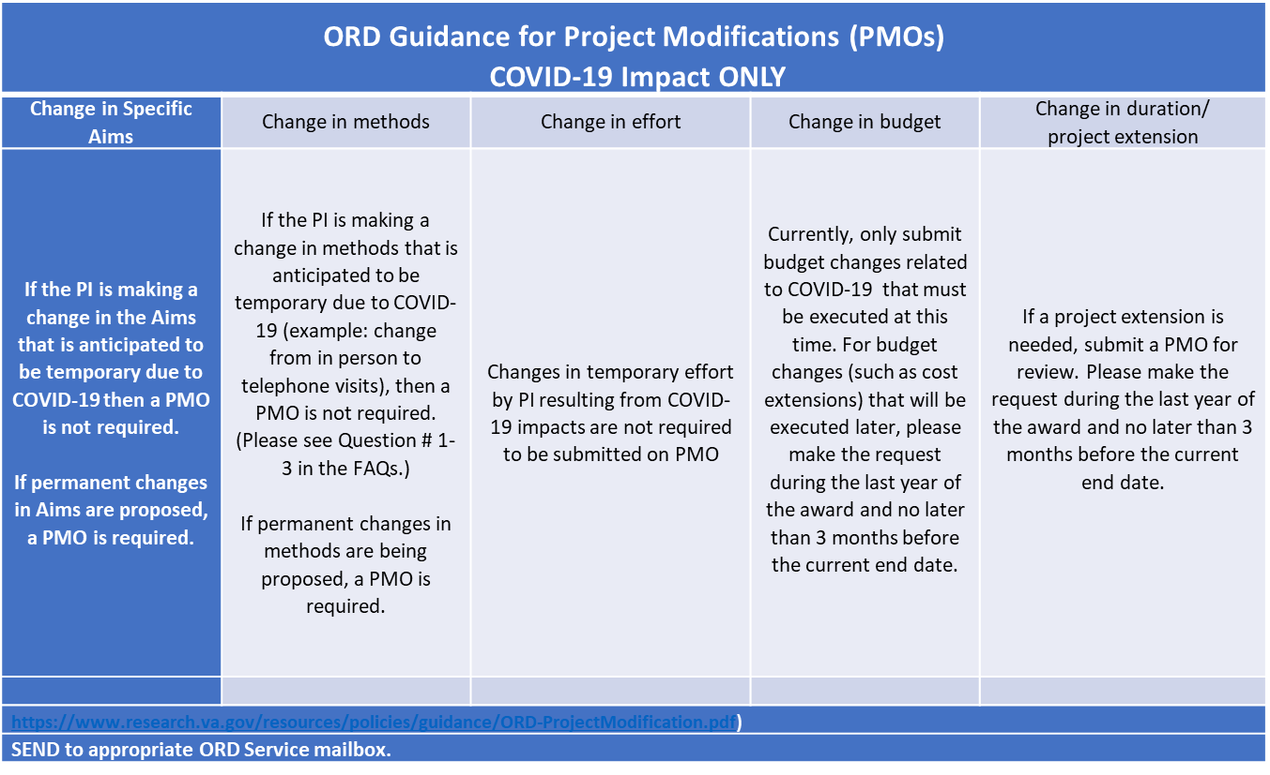
FAQ: Project Modification Opportunity (PMO) update

Slide 14
Communications: General notification procedure
VHA Directive 1200.19 - PRESENTATION OF RESEARCH RESULTS www.research.va.gov/resources/policies/pub_notice.cfm
Scope of directive:
  Applies to all research by VA investigators while on VA time or property. VA investigators are those who do research approved by a VA R&D Committee, whether they are FT, PT, WOC, or on detail via IPA.
  Research can be funded by ORD or other VA or non-VA entities, or unfunded.
  Extends to all forms of VA research results, including publications, presentations, media interviews, and other professional activities.

Slide 15
Communications: General notification procedure
Responsibilities of investigators (first or primary authors):
Notify ORD Communications when:
  Research results are accepted for publication in a journal;
  Presentations are scheduled involving a national venue or the media;
  Media interviews are scheduled; or
  Professional activities are scheduled that involve a national venue
Responsibilities of ACOS/R&D and VAMC Director:
Ensure that investigators know the guidelines for how and when to notify ORD Communications, and for acknowledging VA support.
How to notify ORD Communications:
Researchers or their designees must submit notifications via ORD’s PubTracker system: http://vaww.pubtracker.research.va.gov.
Details at www.research.va.gov/resources/policies/pub_notice.cfm.

Slide 16
Communications: Special request re: COVID-19 pubs
If researchers at your site have submitted or plan to submit a COVID-19-related manuscript to an online preprint site such as www.medrxiv.org or www.preprints.org, let us know via an email to ORDCOVID19@va.gov. Include “COVID-19 publication” in your subject line; attach the abstract or full paper; and include any pertinent details in the body of the email.
If researchers at your site have submitted or plan to submit a COVID-19-related publication to a journal, let us know via an email to ORDCOVID19@va.gov, following the procedure described above.
  General guidance, per Directive 1200.19, remains to use PubTracker to notify ORD of research publications upon acceptance by a journal. With COVID-19-related research, we are asking that you make us aware at the submission stage via email. Items should be re-submitted via the standard PubTracker route once investigators receive notice of journal acceptance.
Notify local leadership as well (VAMC director, chief of staff).

Slide 17
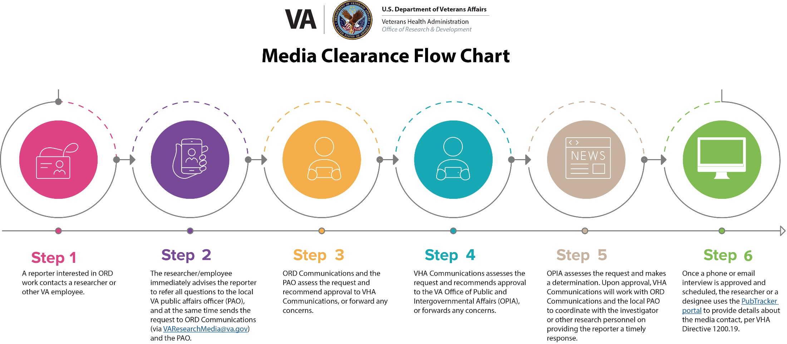
Communications: Media clearance process
www.research.va.gov/resources/policies/Media-clearance-flow-chart.pdf

Slide 18
Office of Research Protections, Policy and Education
Numerous Webinars, Guidance Documents and FAQs being generated related to the COVID-19 Pandemic
  Expanded Access
  Human Subjects Protections Issues
  https://www.research.va.gov/programs/orppe/education/webinars/default.cfm
Supporting Expanded Access Programs within VA
  Mayo Clinic Expanded Access Program – Convalescent Plasma
  VA Facilities without Federal Wide Assurances: Expanded Access Program for COVID-19

Slide 19
Office of Research Protections, Policy and Education
Streamlining IRB Reliance and Exception
  Commercial IRBs approved by ORD
VAIRRS:
  14 sites active; 6 sites scheduled to go live early May
  Status of Tier 1, Tier 2, and Tier 3 onboarding
ORD Privacy Officer Hired

Slide 20
Animal Research FAQs
https://www.research.va.gov/programs/animal_research/animal-care-FAQ-COV-19.docx
Please contact CVMO for any problems: Michael.fallon@va.gov, 404-732-5471
Primary goal: maintain continuing care for animals
Primary Focus: maintain health of animal care staff
  Local programs have discretion in limiting non-care personnel from animal facility, depending upon local conditions
  Local programs have discretion on continuing ongoing studies and when new ones may be initiated
IACUC Meetings- teleconferencing strongly suggested
Semi-annual reviews- May be conducted by a single person for non-USDA species (mice, rats)
Requirement for annual IACUC reviews of non-USDA species is waived

Slide 21
Animal and Laboratory SARS-CoV-2 Virus Studies
Animal Studies:
All animal studies involving infectious virus must be conducted at Animal Biosafety Level 3 (ABSL-3) containment, as defined in the CDC “BMBL”, Biosafety in Microbiological and Biomedical Laboratories, 5th Edition, Section V, “Vertebrate Animal Biosafety Level Criteria for Vivarium Research Facilities.” (https://www.cdc.gov/labs/pdf/CDC-BiosafetyMicrobiologicalBiomedicalLaboratories-2009-P.PDF). This requirement is mirrored in a World Health Organization (WHO) document, “Laboratory biosafety guidance related to
coronavirus disease (COVID-19) dated March 19, 2020 (https://apps.who.int/iris/rest/bitstreams/1272450/retrieve; page 3).
Laboratory (Bench) Studies:
All laboratory studies involving infectious virus must be conducted at Biosafety Level 3 (BSL-3) containment, as defined in the “BMBL” (link above). The WHO document referenced above also has many specific recommendations for laboratory studies.

Slide 22
Use of Offsite BSL-3/ABSL-3 Facilities
VA researchers may utilize the affiliate’s BSL-3/ABSL-3 facility if there is an MOU specifically in place for the use of BSL-3 or ABSL-3 space. There is a template MOU located at:
https://www.research.va.gov/resources/policies/off-site.cfm
An offsite waiver is also needed if the space is controlled by a VA investigator.
If VA researchers are partnering with a non-VA team who will be conducting the work in their own space, an MOU is still needed, but an offsite waiver is not.
For the purposes of applications involving SARS-COV-2 virus this Spring, a letter stating these requirements will be in place before funding is in place is required in the application, signed by either the ACOS or medical center director.
Contact Dr. Amanda Hunt (Amanda.hunt@va.gov) for information and assistance.

Slide 23
Use of Offsite BSL-3 Facilities – Field Perspective
Because VA has few active BSL3 facilities, many of you may seek outside facilities for the use of ABSL/BSL 3 facilities:
Start the Process Early!
  MOU – Template will need to be reviewed by the affiliate. Depending on the affiliate and their processes, there could be a lengthy wait time and may require negotiation of the language.
  Access to BSL-3 Facility – If VA personnel are going to access the BSL-3 facility and haven’t previously gone through the process, it can take months to get required security clearances.
  Non-VA Lab conducting work – May need contract, IPA agreements, purchases, etc.
  Engage your Institutional Biosafety Committee (IBC), Subcommittee on Research Safety (SRS) and R&D Committee early so that they are aware of the off site work and the MOU.

Slide 24
Human SARS-CoV-2 Samples
Specimens from COVID-19 patients require BSL-2 containment. However, if the samples are being manipulated and there is risk of aerosolization or if virus is being concentrated then this work should be conducted with BSL-3 containment.
Please remember VA specimens should be stored in VA space (in VA owned facilities or leased space).

Slide 25
VA SARS-CoV-2 Biorepository Working Group
Charged to develop a plan for a COVID-19 Biorepository System:
participating in on-going national biospecimen collections and collaborations
development of VA biospecimen collection(s)
governing policies and procedures for VA samples
  ethical considerations
  collection of biospecimens
  storage
use of samples
  cooperation and coordination across investigator participants
  availability for research collaborations with VA and non- VA investigators
development of an executive oversight committee

Slide 26
Ramping Up
Notification of Return to Work (adjustment of remote work plan)
Facility Function
Supply Chain Considerations
Health Plan
Social Distancing
Disinfection/Hygiene
Basic Infection Prevention
Infectious Disease Preparedness Plan
Education/Communications

Slide 27
Wrap Up
Please do not hesitate to send questions, ideas, issues or concerns to ORDCovid19@VA.gov
Questions???????????

Slide 28
AVAILABILITY OF RECORDING
A recording of this session and any associated handouts will be available on ORPP&E’s Education and Training website approximately one week post-webinar.
https://www.research.va.gov/programs/orppe/education/webinars/archives.cfm
28

